Slide 1


Interventions that Protect Your Medical Staff
Elizabeth (Beth) Korinek, M.P.H., CEO

Slide 2
CPEP
CPEP Participation
Past 10 years
Mission-driven 501(c)(3) non-profit
Mission is to help clinicians, hospital systems and regulators objectively address performance concerns in clinical competence and other core competencies
Serving more than 760 clinicians per year from the US and Canada
Participants include physicians, PAs, APNs, podiatrists and a wide variety of other clinicians
Receive no funding from licensure fees
Thank you for your donations!
CPEP has helped almost 4,000 clinicians in the past 5 years!

Slide 3
CPEP Board of Directors
11 clinician board members
3 non-clinician members
Christopher Awtrey, MD, MBA – Intermountain Health
Diana Breyer, MD – UCHealth
Brian Davidson, MD, MBA – Cigna
Shawn Dufford, MD, MBA – Memorial Health System (MS)
CPEP Board Immediate Past President
Shauna Gulley, MD, MBA – CommonSpirit
CPEP Board President
Carmelo Hernandez, MD – San Luis Valley Regional Med Ctr
Russell Howerton, M.D. – Wake Forest System, NC (NC)
Lisa Kettering, MD – LINC MD
Jennifer Rodgers, DNP, APRN – UCHealth
Phillip Stahel, M.D. – HCA, North Carolina Division (NC)
Alexis Angell, JD – Polsinelli (TX)
CPEP Board President-Elect
Sean Gelsey, MBA – COPIC
CPEP Board Treasurer
Susan Diaz, CPCS, CPMSM – formerly NY Presbyterian Hospital System (NY)
Major health systems represented; 5 states
All volunteers: Board members receive no compensation for their board service

Slide 4
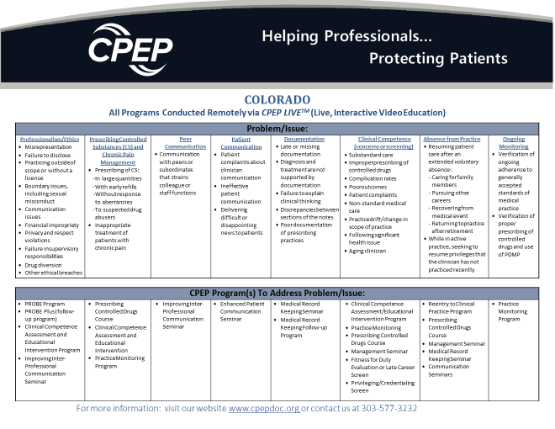

Slide 5
Practicing but not perfect…. Examples of Unprofessional Conduct
Internist sent unwanted texts of flirtatious and sexual content to a resident
General surgeon prescribed a benzodiazepine to spouse on several occasions
Doctor under review for poor documentation goes through other physicians’ patient records to “prove” he’s no different than anyone else
Physician left shift early and did not respond to patient code
Surgeon yelling and belittling staff in the OR
Hospitalist dismissed from 3-year fellowship after first year; represented to the hospital that it was just a 1-year program and did not disclose dismissal

Slide 6
When to Consider CPEP Seminars
Cup of coffee chats are not effective - behavior is not changed or sustained
Multiple issues have been tracked and trended with no improvement
Taking action with a voluntary agreement or performance improvement plan
Under Review
Fine tuning
Cup of coffee chat

Slide 7
Ways to Intervene
Assessments and Educational Intervention
Skill-building Seminars Professionalism, Communication, Documentation, Prescribing Controlled Drugs
All CPEP services are confidential and are not reportable to the medical board or the NPDB unless the referral is part of a larger legal action

Slide 8
Types of Assessments
Clinical Competence
Questions about clinical performance
Reentry to Clinical Practice
Requesting privileges after a break from practice (for non-disciplinary reasons)
Specialized Assessments
Re-eligibility Programs for several ABMS Member Boards
Assist with questions about specific privileging requirements
Other

Slide 9
Overview of Skill-building Seminars
Improving Inter-Professional Communication
Provides insight and action plans to help clinicians repair and reset damaged relationships with peers and staff
“This program was life-changing for our orthopedic surgeon”
PROBE Program
Professionalism, boundaries and ethics
Helps clinicians understand professionalism standards and apply them to their specific situation; our busiest program with 360+ participants per year
“Helped me realize the full impact of my mistakes”

Slide 10
Overview of Skill-building Seminars
Enhanced Patient Communication
Helps clinicians who struggle to engage with patients and demonstrate empathy
Medical Recordkeeping Seminar
Our second-busiest resource, helps with everything from basic skills through reducing medico-legal risk and time management
“I was able to make goals that I can operationalize as soon as next week”
Prescribing Controlled Drugs
Resource that teaches safe prescribing practices and helps prescribers recognize drug-seeking patients and develop strategies to manage those difficult situations
“Got me thinking about my own influences and how they allow me to ‘give in to the patient’”
“It's easy to say "be more empathetic" but examples and techniques, especially with an opportunity to practice them, is priceless”

Slide 11
Seminar Basics
Intensive, interactive, multiday
Expert faculty and limited class size
Use tools such as
Follow-up programs
Feedback or report from faculty
Discussion of the participants’ specific reasons for participation
Development of Personal Improvement/Action Plans
Provide personalized follow-up coaching/mentoring to help participants implement and sustain change
Participants must be on camera and actively engaged
Interactive discussion and feedback
Practice with simulated patients
2 – 3 faculty per session
8 – 16 participants

Slide 12
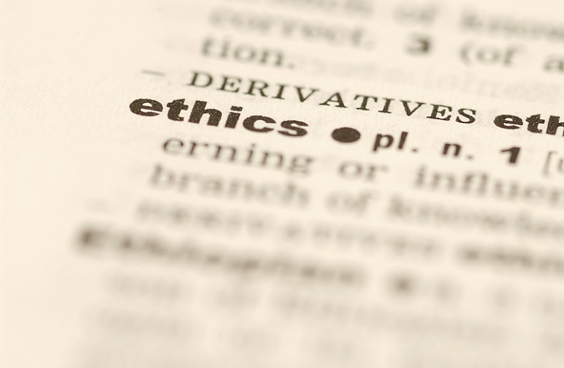
The PROBE Program
Educational intervention in ethics for health care practitioners who are under discipline by their licensing body or other oversight agencies
24 sessions per year for the U.S. and Canada
21 expert faculty members
Represent various healthcare professions
From U.S. and Canada
Small-group, intensive intervention
Max of 16 participants per session with 2 – 3 faculty
21.25 hours CME
For seminar attendance as well as pre- and post-seminar work
Notes:
380 participants in 2021 alone

Slide 13
PROBE: Professionalism, Ethics and Boundaries
Seminar: didactic learning and personal reflection
What it means to be in a “profession”; ethical theories and ethical codes; professional-client relationships, including boundaries; accountability in healthcare professions
Sharing of infractions that led to referral and application of learning to one’s own conduct
Final Essay: to demonstrate learning and application to one’s conduct and behaviors
Demonstrate sufficient facility with ethical theories to be able to apply to future dilemmas
PROBE PLUS: Follow-Up Program (optional)
Final Grade: Unconditional Pass; Conditional Pass; Fail
Based on Final Essay (major) and Seminar preparation/participation (minor)
Longitudinal, personalized program providing 6 months of structured interaction between participant and faculty member

Slide 14

Case Study
Dr. Merlot is an Ob/Gyn who was called in to attend a delivery 12:30 AM.
She made inappropriate comments to the patient; was loud and boisterous; had slurred speech; gave orders that did not match what she entered in the EMR.
When confronted by staff, she admitted she had consumed wine prior to coming to the hospital.
She was suspended and entered a recover program.
After 6 months, she was cleared by the Physician Health Program to resume practice and will remain under their monitoring.
The hospital requested that she successfully complete an ethics remediation seminar as a condition of her return to practice.

Slide 15
Case Study
Final Essay
“I was accused of unprofessional conduct posing a serious risk to patient safety and failure to take responsibility or accountability for the amount of alcohol imbibed.”
“Were the allegations brought against me correct and just? Absolutely. Attending the Seminar helped me realize how many ethical violations I had committed.”
“I am once again humbled at the risks I took to my patient but also to the integrity of myself and my profession.”
“During the course, I felt I was taking a step back in my recovery, but further reflection makes me realize that as painful as it was, I did make those steps forward in order for me to recognize the full impact of my mistakes.”

Slide 16
Case Study
Final Essay
“I was accused of unprofessional conduct posing a serious risk to patient safety and failure to take responsibility or accountability for the amount of alcohol imbibed.”
“Were the allegations brought against me correct and just? Absolutely. Attending the Seminar helped me realize how many ethical violations I had committed.”
“Through this class, I now realize that my process of recovery will be on going for some time. I am once again humbled at the risks I took to both my patient but also to the integrity of myself and my profession.”
“During the course I felt I was taking a step back in my recovery, but further reflection makes me realize that as painful as it was, I did make those steps forward in order for me to recognize the full impact of my mistakes.”
PASS

Slide 17
Improving Inter-Professional Communication: Working Effectively in Medical Teams
Real-life situations leading to enrollment in seminar:
“Belittling, demeaning or unfairly critical comments”
“Yells at residents in front of patients, ‘makes them feel inept’”
“Gender-charged comments and comments viewed as racially insensitive”
“Communications were ‘intimidating’, ‘bullying’, ‘harassing’, ‘belittling’, ‘condescending’, ‘nasty”
“This program was life-changing for our orthopedic surgeon”
Recent feedback from a Chief Medical Officer

Slide 18
Improving Inter-Professional Communication: Working Effectively in Medical Teams
2.5-day course; 12 participants with 3 faculty per session
Provides awareness raising, education and skill-building needed to employ professional and effective communication and to support sustained behavior change
Helps participant address issues such as
Owning their behavior/personal accountability
Recognizing individual behavior/communication styles and impact on teams
Improving communication techniques
Understanding emotional intelligence
Using more effective strategies to manage stress
Increasing resiliency and improving tolerance for frustration
Repairing damaged relationships
Participants create Action Plan for Sustained Change with faculty input
Faculty provide report on participation and recommendations - signed release to share with Committee
Recommend 6-session follow-up program – separate enrollment and fee
Faculty member serves as an accountability partner to provide on-going feedback, coaching and support to help achieve meaningful improvement in communication and team interactions

Slide 19

Case Study
There have been multiple complaints about Dr. DoRight. He berates nurses and colleagues when they are not providing care in the way he thinks is best.
The complaints are referred to the Citizenship Committee. A Committee Chair sets up a meeting with Dr. DoRight to relay the concerns.
Dr. DoRight began by saying that he is always striving to make sure that patients get the best care. He said he would work on improving his communication.
Over the course of 6 months, the complaints continued.
The Chair has additional meetings with him to discuss the concerns. Dr. DoRight acknowledges the incidents but does not make sustained changes in his communication.

Slide 20
Case Study
Dr. DoRight made a nasty comment to a resident that was witnessed by the nursing staff.
The Citizenship Committee asked that he complete
An inter-professional communication seminar
The 6-session follow-up coaching program
The Committee reviewed the faculty report and Dr. DoRight’s action plan.
The Committee appointed an accountability partner to meet regularly with Dr. DoRight to provide feedback.
Dr. DoRight, the Chair and the accountability partner noted sustained improvements in how he communicated with staff and handled frustration.
“Dr. DoRight realized he had many burned bridges to repair, and he has worked diligently to do so.” CMO

Slide 21

Questions?
Feel free to contact me if you have any questions!
Beth Korinek
bkorinek@cpepdoc.org

Slide 22
Appendix

Slide 23
Professionalism Concerns in the Hospital Setting
Inappropriate touching
Sexual banter & suggestive behavior in OR
Yelling or berating team members
Discriminatory acts towards or comments about patients and colleagues
Unauthorized access of EMR
Inadequate supervision of PAs or residents
Boundary violations, including prescribing to friends or family

Slide 24
Was there a change in this person’s communication/behavior with colleagues after the seminar?
No
improvement
Slight
improvement
Moderate
improvement
Significant
improvement
Very significant
improvement
= average response of Chief Medical Officers, Med Staff Presidents, and others
73% of responding organizations report a lasting, sustained improvement
Comments from referring organizations
“Mutual respect and increased sensitivity to people of all races and cultures”
“Dr. X is more kind when speaking to colleagues and support staff”
“Recognition that his expression of anxiety comes across to others as an uncaring or dismissive attitude”
“He knew he had many fences to mend and burned bridges to repair
and he has worked diligently to do so”
Notes:
CPEP is an independent, community based, mission-driven non-profit organization. We are not a company. We were founded in 1990 by a consortium of organizations representing stakeholders in the Colorado healthcare community, including the Colorado Medical Society, the Osteopathic Medical Society, the Colorado Hospital Association, the University of Colorado School of Medicine, and others.
These organizations were looking to fill what was then an unmet need – the need for a resource that could evaluate and, when necessary, remediate physicians when questions of clinical skills or competence came up.
The structure they came up with is still in place today, almost 30 years later. The two pillars of that structure are 1) Non-profit status, and 2) independence.
As a non-profit organization, we are not driven to seek maximum economic advantage from our programs. While our programs are costly, we work hard to make our resources as accessible as possible, to the point that we provide tens of thousands of dollars in discounts to PROBE participants with more limited incomes – over $50,000 in 2018 alone.
Independence means just that. We are not an extension of any licensing board or hospital system. That independence is critical to keeping our work objective and unbiased.

